Slide 1






Interdisciplinary Design
in Games
Presented By:
The International Game Developers Association
Pittsburgh Chapter

Slide 2

Game Design Discipline
Shawn Patton
Game Designer
Schell Games

Slide 3

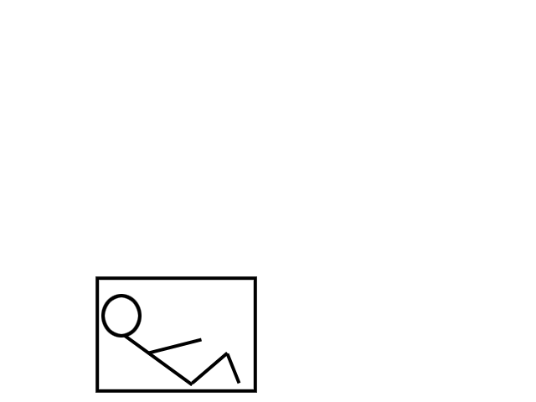
What Do Game
Designers Do?
Games

Slide 4
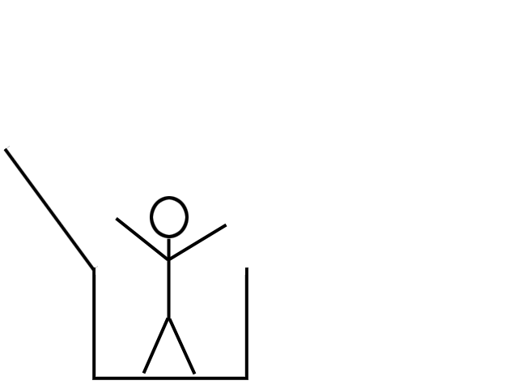
What Do Game
Designers Do?

Slide 5
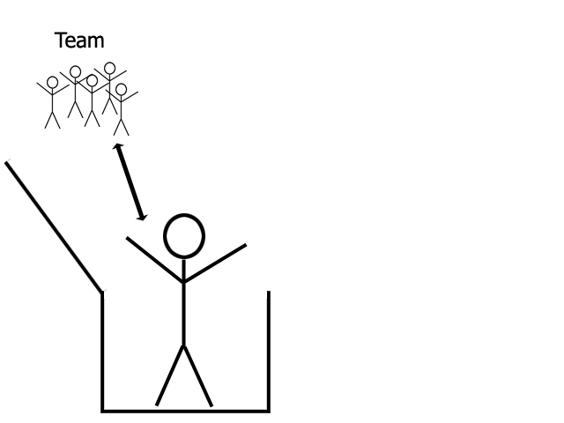
What Do Game
Designers Do?

Slide 6
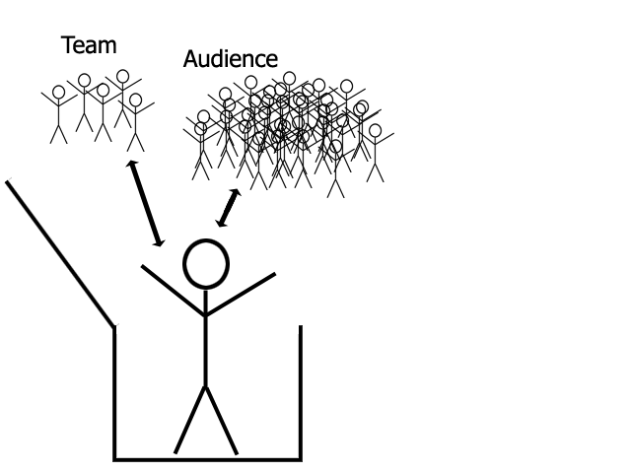
What Do Game
Designers Do?

Slide 7
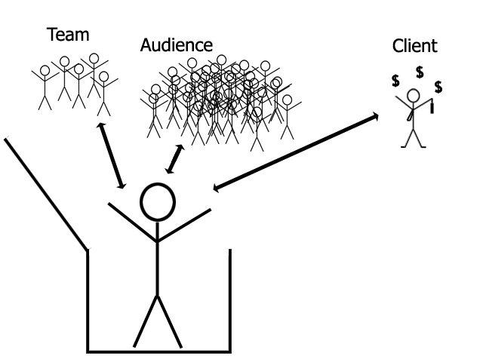
What Do Game
Designers Do?

Slide 8
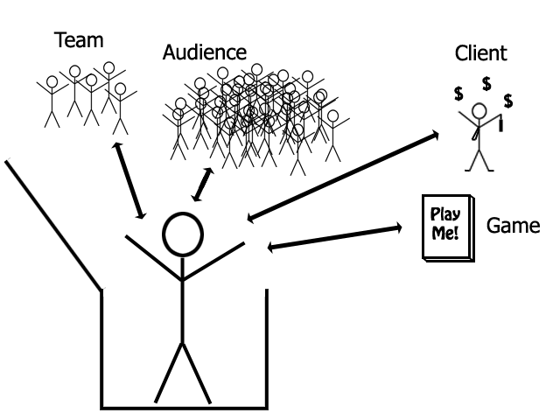
What Do Game
Designers Do?

Slide 9
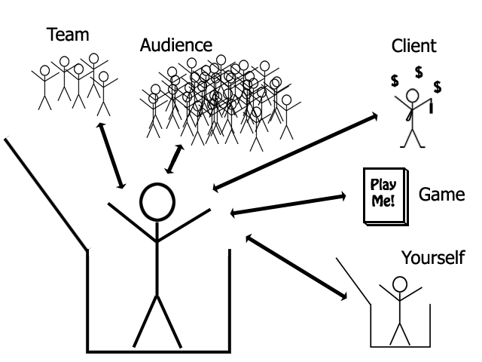
What Do Game
Designers Do?

Slide 10
Process of
Game Design
Have a reason to design a game.
Brainstorm
Sift, strain, and find the “good” ideas
Prototype
Playtest
Experience Doc
Game Design Doc
Develop
Playtest
Repeat 8 and 9 till you run out of time/money

Slide 11
Reason
For fun!
For a client!
For fun and a client!
As a gift!
Did I mention for fun?

Slide 12

Brainstorm
Could be just you, could be a group
Get ideas flowing!
Write down keywords, thoughts, phrases, everything!
No idea is bad during a brainstorm!
(Whiteboards and giant post-it notes are useful if you’re in a group.)

Slide 13
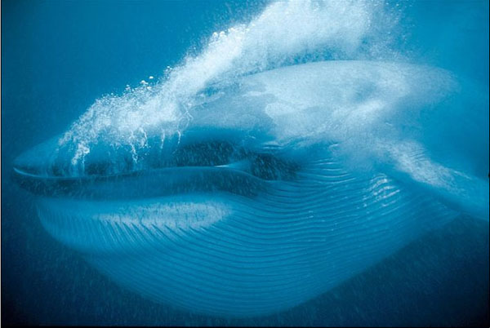
Find “Good” Ideas
Strain feasible ideas from infeasible ideas.
Which ideas kept coming up again and again?
Talk to your team (if you haven’t already)
Try to keep in mind time and money constraints.

Slide 14
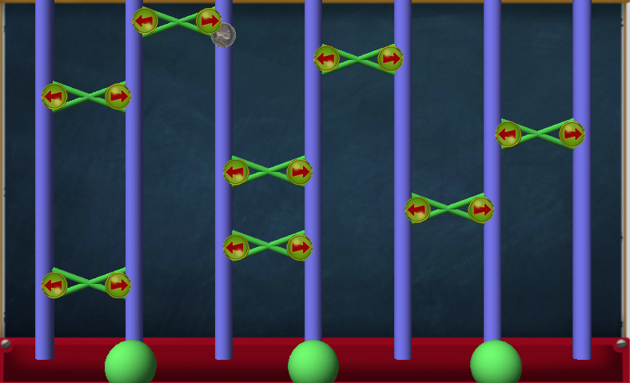
Prototype
Prototypes are quick!
They are easy!
Paper prototype
Prototype in a
known game
engine
Don’t get too
attached to
any one, remember, they should be quick!

Slide 15
Playtest
Playtest with yourself first.
Bring other people in!
Keep in mind your key demographic
Though try not to outright turn anyone away…
Take notes!
Don’t interfere unless you absolutely must!
Let the playtesters know that anything wrong is your fault, and you need their Help to fix the game!
Remember to listen with more than your ears!

Slide 16
Experience Doc
Write out a story of a player playing your game.
“After watching the cool intro cut scene, Timmy clicks on New Game.”
Put yourself in the shoes of a naïve player.
Notice everything you haven’t thought of!

Slide 17
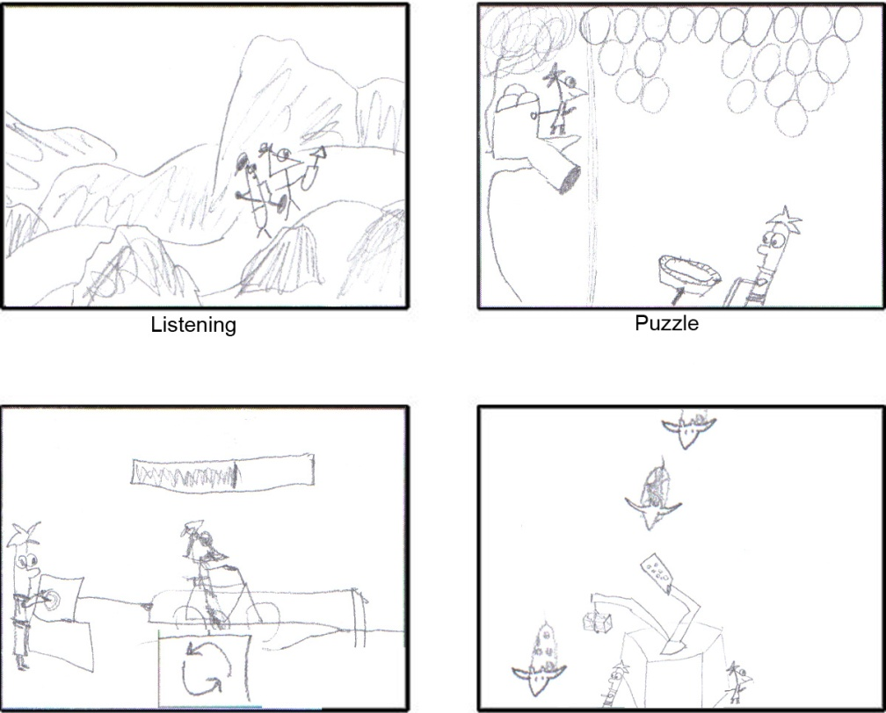
Game Design Doc
Get everything you’ve learned on paper
Keep it readable: Bullet Points are good!
Don’t dig too far down on any one part (yet)
Pictures help a lot!
(even “crappy” ones)

Slide 18

Develop
Make the Game!
Be flexible
Learn from prototypes
and playtesting
Keep listening!
You can do it!

Slide 19
Playtest Again!
Use fresh playtesters!
Seriously… use fresh playtesters.
Iterate the design.
Trust yourself too, run feedback through a filter.
Give people what they need, not always exactly what they want.

Slide 20


Game Design Complete
Just keep repeating until you run out of resources!
Anyone can be a game designer, you just need to practice!
My web: shawnpatton.com
Jesse’s Book : artofgamedesign.com

Slide 21

Game Audio Discipline
Scott Gainar
Composer, Creative Director
Gainar Creative Music

Slide 22

Three Components of Game Experience
  Visual (graphics, art, etc.)
  Gameplay
  Audio

Slide 23
Audio
Three types of audio found in games:
  Music
  Sound Effects
  Dialog (voice-over)

Slide 24
Music
The role of music:
Emotion
Continuity
Source music
Other
  Ambiance
  Effect
  Foreshadowing
  Character themes

Slide 25
Sound Effects
Real
  95% of “real” sounds in film are added after the fact
    Car door
    Foot steps
    Buzz from lighting
    Wind/rain
    Brushing past bushes
    Ambiance
Imagined
  Spaceship
  Creatures
  Futuristic weapons

Slide 26
Dialog
Examples
  Narration
  Character spoken word
Has to be easily understood
Pay attention to other audio elements

Slide 27
Challenges Specific to Game Audio
Non-linear nature of games
  Music
  Real-time “mixing” of audio elements
Need to be technical minded
  Understand integration of audio engine
  Basic programming

Slide 28

Game Programming Discipline
Mark Tomczak
Game Programmer
SimOps Studios

Slide 29



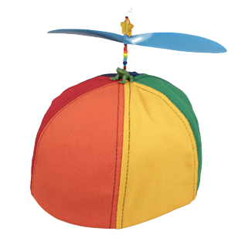
Three Game Programmer Hats

Slide 30
Overview
  Games have rules, context, content
  Programmers are involved in all three parts
    Building rules for the game
    Building context for the game
    Achieving the team's shared vision

Slide 31
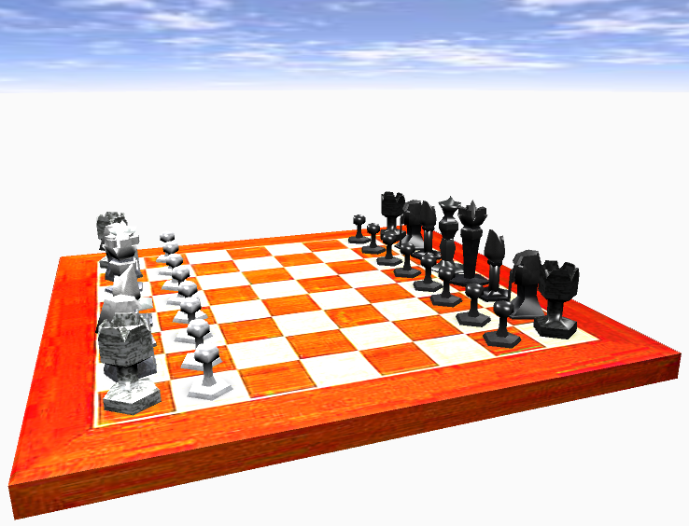
A Game Is Rules
  Game rules usually stated in a language specific to the game
    functions
      movePieceTo
      canCastle
    objects
      chess piece
Notes:
Computers are very good at applying rules to a model: no problem!
Game rules are usually high-level

Slide 32
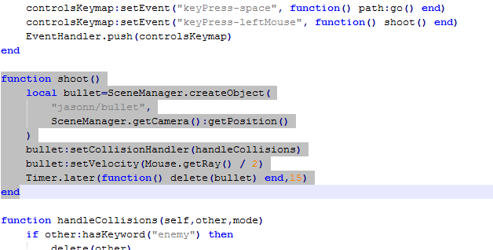
Scripting Language
Notes:
A specialized, high-level language
Helps make easy things easy
Hides the messy parts

Slide 33
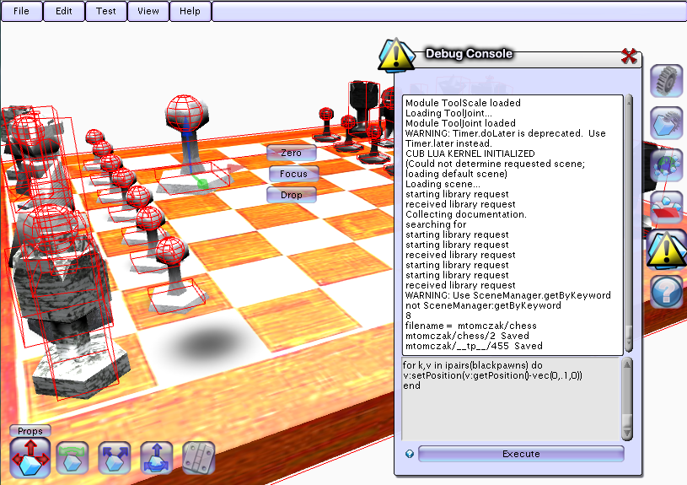
Game rules need a context
Notes:
Computers are very general-purpose machines
Have to teach the computer to play a game
NOT ONLY:
How to move a piece
How to win
BUT ALSO:
How to draw
When to read / write disk
How to use memory

Slide 34
Things I need to teach the computer to do…
  Manage memory
  Draw to screen (render)
    ... quickly
    ... beautifully
    (this is most of the work)
  Play sounds
  Accept commands from the player (input)
    Mouse
    Keyboard
    Joystick
    Wii Remote?
  Simulate an opponent (AI)
  Make things solid (collision)
  Simulate a realistic world (physics)
  Do things at the right time (timers)
  Play with other humans (networking)
  NEVER CRASH

Slide 35
“…but I just want it to play chess!”

Slide 36
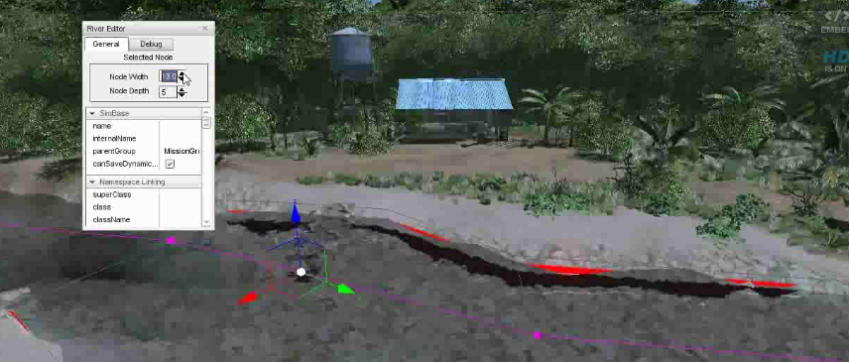
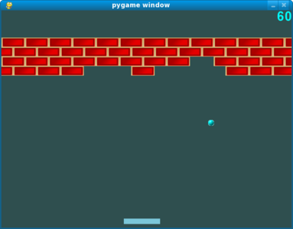
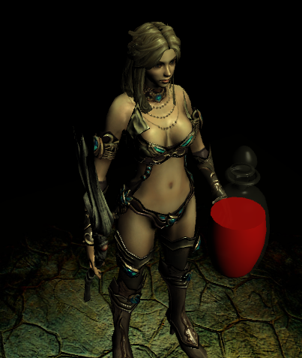

Game Engines
Torque 3D
PyGame
Wild Pockets
Panda3D
Notes:
Handle the messy bits
Some are better for a particular game idea than others
Usually written in a fast, general purpose language (C++, .NET)
For game rules, embeds a scripting language (Python, Lua)

Slide 37
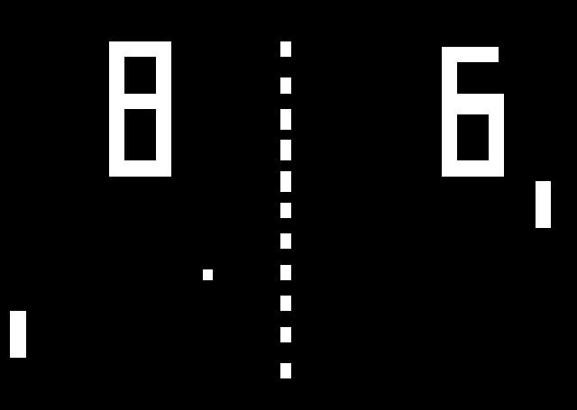
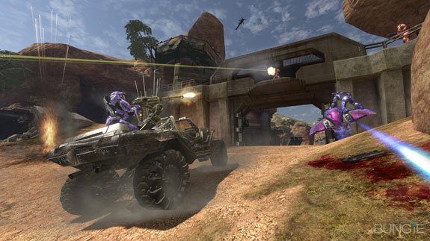
Working With the Team
-vs-
Notes:
Most game programmers don't work alone
Artists need to use the engine
Writers, sound engineers need to put content into game
Tools let other people build the game with you

Slide 38
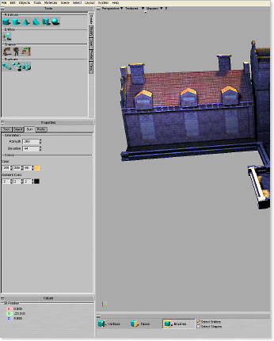
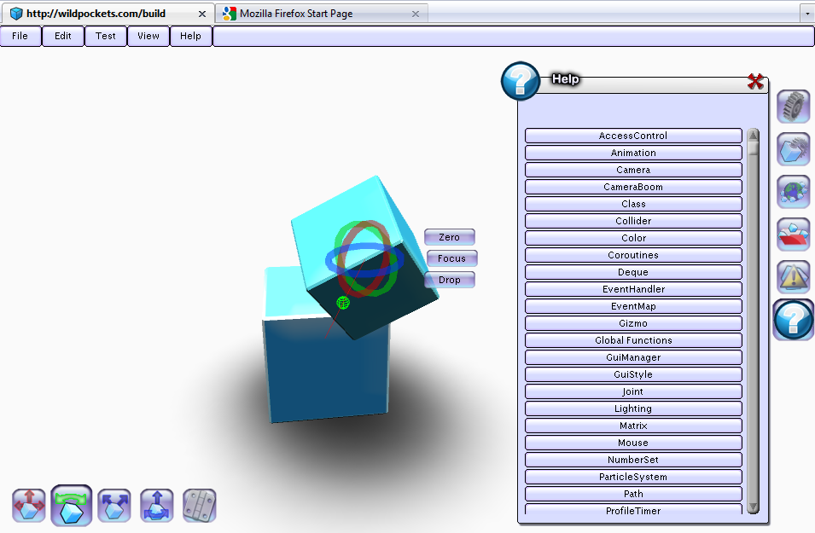
Developer Tools
Torque Constructor
Wild Pockets Builder
Good Game Design is About Iteration
Notes:
Expose the power, hide the messy bits (like the engine for the scripter)
Good game design is about iteration
Good tools: more iterations
Immediate feedback is key
"Get in the groove"

Slide 39
Thank You!

Slide 40

Game Production Discipline
Andy Jih
VP of Production, Evil Genius Designs
Producer, Schell Games

Slide 41

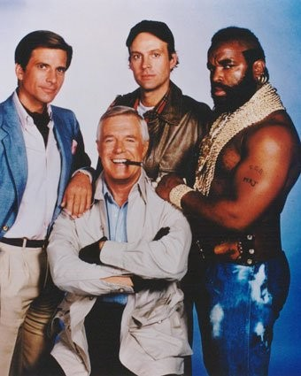




Team
Client
Budget
Schedule

Slide 42

Pick 2

Slide 43


Communication

Slide 44

Game Art Discipline
Nick McClay
Game Artist
SimOps Studios

Slide 45

Artist’s Role
  To design the visual impression of the game
  Create the Characters
  Build the World
  Design the style of the entire game
  Use visual design to enhance the game’s design
  Building Intuitive Interfaces
  Creating clear visual cues for game mechanics
  Influencing player perceptions

Slide 46




Defining a Style

Slide 47
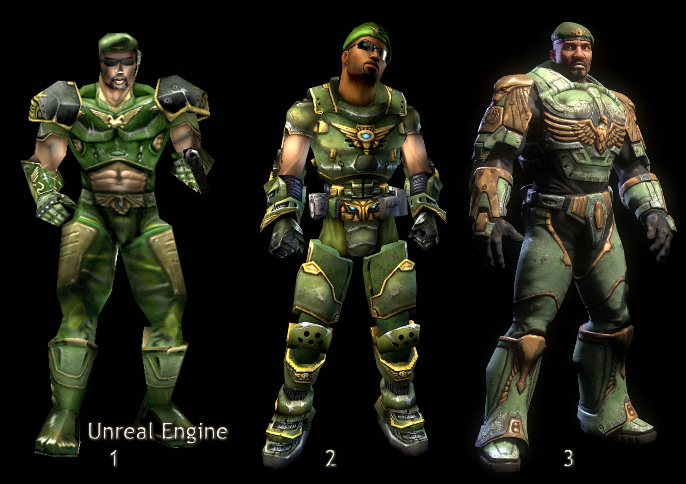
Style is Independent of Technology

Slide 48
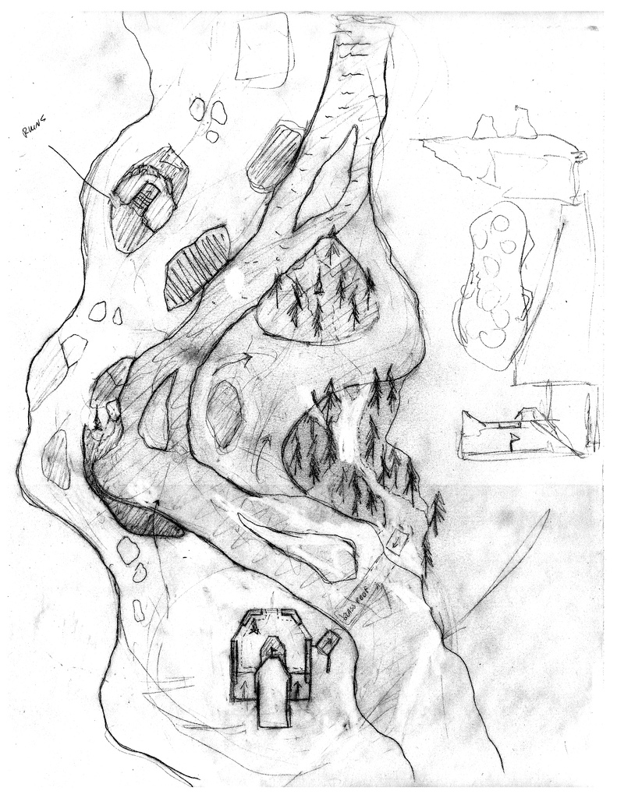
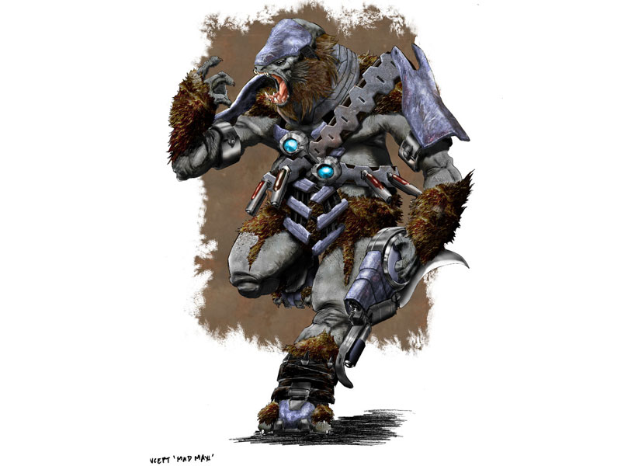
Concept Art

Slide 49
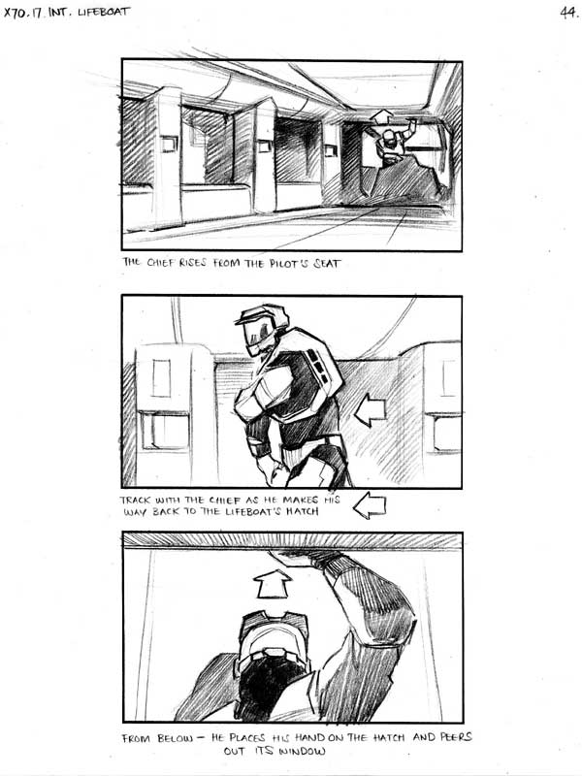
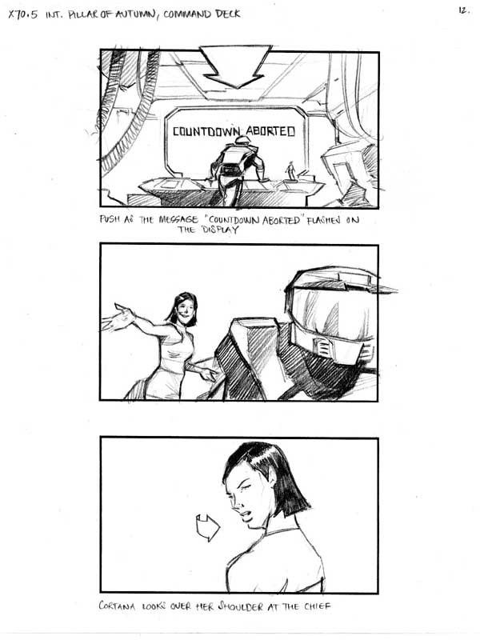
Storyboards

Slide 50
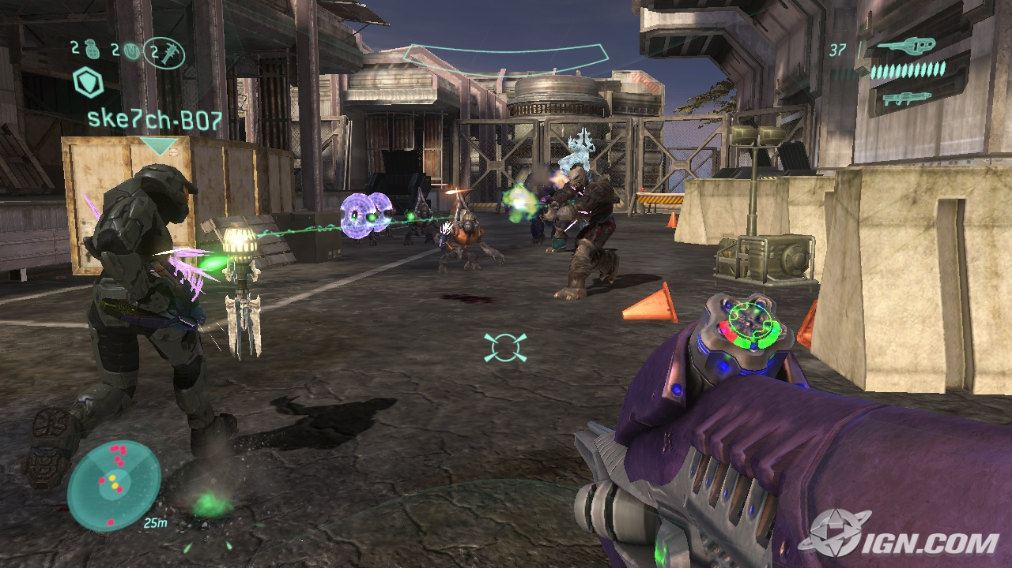
Assets

Slide 51
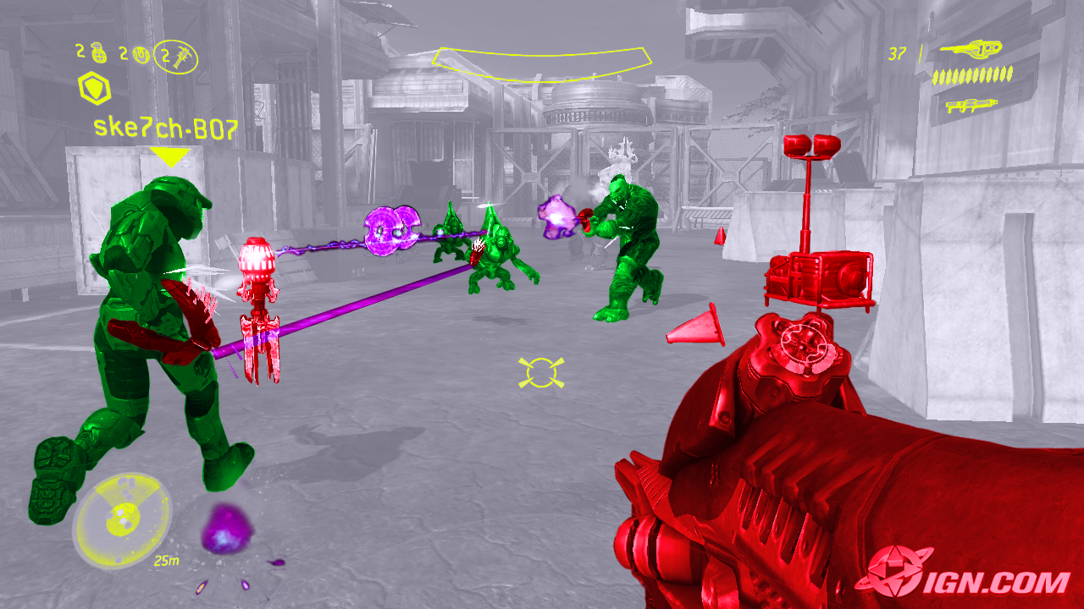
Assets

Slide 52
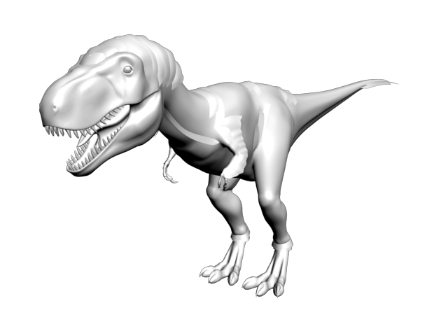
Prototype Asset

Slide 53
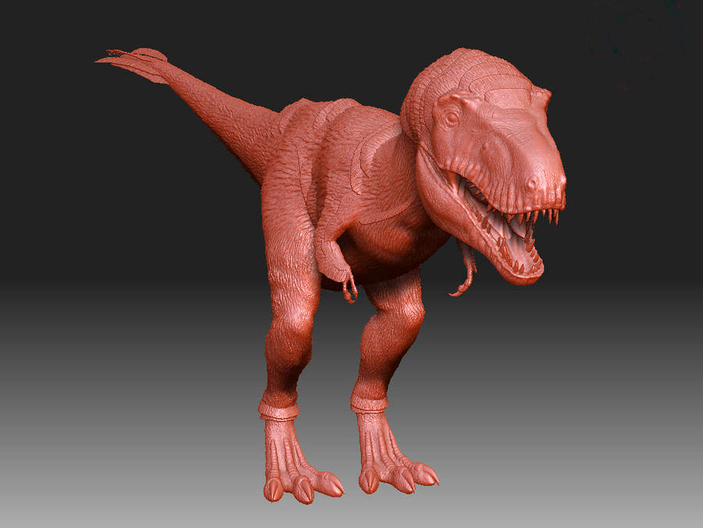
Taking it to the next level

Slide 54

Finished Asset

Slide 55
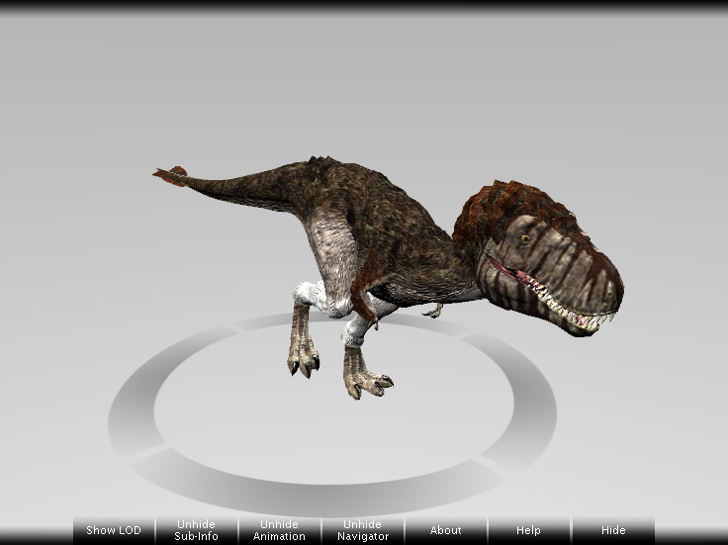
Game Engine Integration

Slide 56
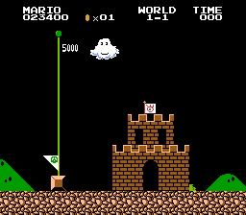
Thanks!

Slide 57
Thank You
For more information about the Pittsburgh IGDA Check out:
www.igda.org/pittsburgh

