Slide 1
Who is this guy?

Slide 2
Shawn Patton
2003 CMU ETC Grad
10 years at Schell Games
(I apologize for my barebones slides, but focus on the learning, not the flair.)

Slide 3
Show of Hands
Comfortable with probability?
Comfortable with scripting?
Comfortable with Excel?

Slide 4
Probability
(Or, the chance something will happen.)

Slide 5
Like, the likelihood of getting hit by lightning?
No, not quite, not today at least
Specifically for game design
Mathematics of probability invented as a result of game design
1654: Stemmed from questions the French Nobleman Antoine Gombauld, the Chevalier de Méré, posed to Pascal & Fermat
Let’s play a game. Pair up! (3 dice per pair)

Slide 6
Split Into Pairs
Partner A: Will roll 1 die 5 times: Trying for a 6
Partner B: Will roll 2 dice 5 times: Trying for a 7
Who will win?

Slide 7
Show of hands:
Which Partner Will Win
Partner A:
Partner B:
Both:

Slide 8
6 of Jesse Schell’s
10 Rules of Probability
(reordered & renumbered by me)
Fractions are Decimals are Percents
½ = 0.5 = 50%
Divide a fraction to get a decimal
  (Calculators are your friends) (turn your iPhone for scientific)
Multiply a fraction by 100 to get percent
  (or just move the decimal to the right twice)
But you may want to leave things as fractions, resist the urge to simplify

Slide 9
2. Zero to One
0 to 100%, that’s it!
No -10%
No 110%
Good quick check for miscalculations

Slide 10
3. “Looked For” divided by “Possible Outcomes” equals Probability.
Roll a 6 on a normal die?
1 of 6 outcomes
1/6 = .16666 = ~17%
Probability of it:
Number of ways *it* can happen / Total options

Slide 11
4. In certain cases, OR means add
Got a this or that problem?
If they are mutually exclusive*

Slide 12
Mutually Exclusive = Can’t happen at same time
Turning left and turning right are Mutually Exclusive (you can't do both at the same time)
Tossing a coin: Heads and Tails are Mutually Exclusive
Cards: Kings and Aces are Mutually Exclusive
Not Mutually Exclusive
Turning left and scratching your head can happen at the same time
Kings and Hearts, because you can have a King of Hearts!

Slide 13
4. In certain cases, OR means add
Got a this or that problem?
If they are mutually exclusive*
Add the individual probabilities!
Ex: Draw a face card or ace from deck?
12/52 + 4/52 = 16/52 = ~31%
Probability of drawing Ace or Spade?
(it’s a trap)
52/4 = 13 + 4 aces = 17 / 52 right?
Ace of Spades ➔ 16/52
P(A or B) = P(A) + P(B) - P(A and B)

Slide 14
5. In certain cases, AND means multiply
Got an AND problem?
If they are NOT mutually exclusive (independent events)
Multiply the individual probabilities!
Ex: Get two 6s rolling two dice: (a six AND a six)
1/6 * 1/6 = 1/36 = ~3%
Ex: Get 5 heads out of 5 coin flips:
(½)^5 = 0.03 = 3%
Ex: Rolling a 2 and flipping a head:
1/6 * 1/2 = 1/12 = 0.0833 = 8.3%

Slide 15
6. One minus “Does” = “Doesn’t”
P(not E) = 1 – P(E)
Sometimes it’s easier to calculate chance of something not happening
Probability of Not rolling a 6?
6/6 – 1/6 = 5/6
Not rolling a 6 AND not rolling a 6 AND … 5 times
(5/6)^5 = 0.4018
1 – 0.4018 = 0.598 = ~60%

Slide 16
Probabilities of our Game?
Partner A: Will roll 1 die 5 times: Trying for a 6
  ~60%
Partner B: Will roll 2 dice 5 times: Trying for a 7

Slide 17
Probabilities of our Game?
Partner B: Will roll 2 dice 5 times: Try for a 7
Not roll a 7?
How many ways to roll a 7?
3? But either die could be either number
6 out of 36
(resist urge to simplify fraction)
Not roll a 7 = 30/36
Not roll a 7 five times = (30/36)^5 = 0.4018
1 – 0.4018 = 0.598 = ~60%

Slide 18
Probabilities of our Game?
Partner A: Will roll 1 die 5 times: Trying for a 6
  ~60%
Partner B: Will roll 2 dice 5 times: Trying for a 7
  ~60%
  They’re the same! Ha!

Slide 19
Expected Value
What are outcomes worth in your game?
The value of an action, positive or negative
Rule: Land on a green space, roll a six sided die, get that much power:
1+2+3+4+5+6 = 21 / 6 = 3.5 expected value

Slide 20
Expected Value Cont.
Take probability of all outcomes one by one, multiply by their values to the game, add up all those numbers. That’s expected value of that action.
Ex: Roll two dice: 11 = $5. 7 = $5. Anything else = -$1
Outcome | Chance x Outcome | Value
11 | 2/36 x $5 | $0.28
7 | 6/36 x $5 | $0.83
Everything else | 28/36 x -$1 | -$0.78
Expected Value |  | $0.33

Slide 21
Skill vs. Chance
Skill (physical, mental, social) in games can improve over time
Chance, or probability, remains constant
It adds surprises which normally equals fun
Treat it as a spice though, too much and you’ll over power your game to its detriment

Slide 22
Uses of Chance
Movement
Attack & Defense
Weighted Chance could be your AI
Higher chance of shot hitting you in FPS means players think your bots are smarter
Loot Drops – Rarer things are more awesome!
Remember - It’s the spice!

Slide 23
Emotion of Chance
Pre Luck vs Post Luck
Post Luck:
  Good roll? I’m awesome at this game!
  Bad roll? The game or fate is against you. Boo!
Pre Luck:
  Good roll? Capitalize on it! I’m awesome at this game!
  Bad roll? Make the best of it. I’m smart!

Slide 24
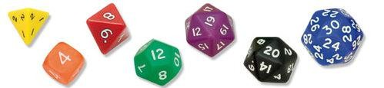
Weighted Chance
Formula D Dice
Different gears = different dice
d4 - 1st gear 1,1,2,2
d6 - 2nd gear 2,3,3,4,4,4
d8 - 3rd gear 4,5,6,6,7,7,8,8
d12 - 4th gear the numbers 7 through 12 twice
d20 - 5th gear the numbers 11 through 20 twice
d30 - 6th gear the numbers 21 through 30 three times

Slide 25
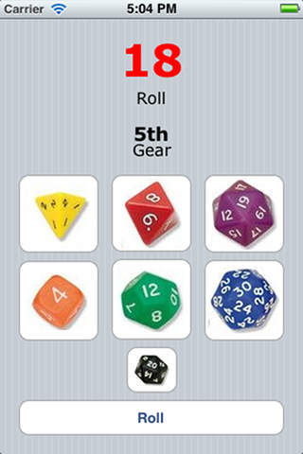
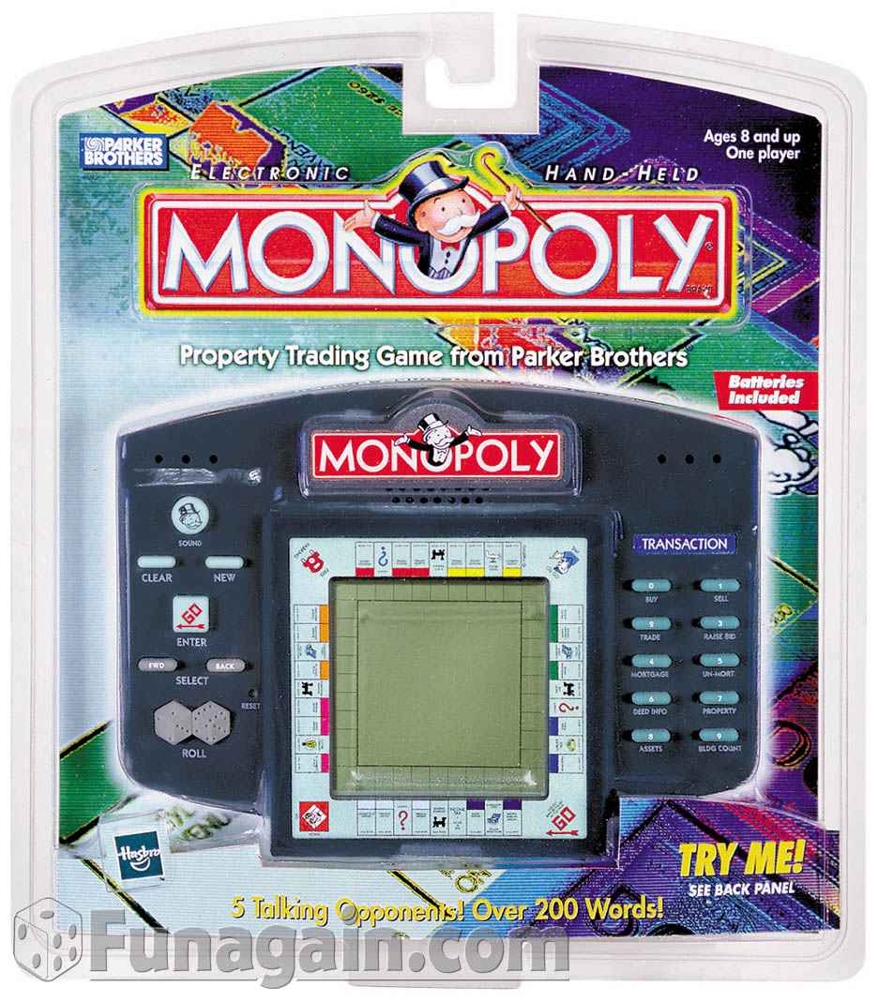
Don’t Underestimate the Fun!

Slide 26
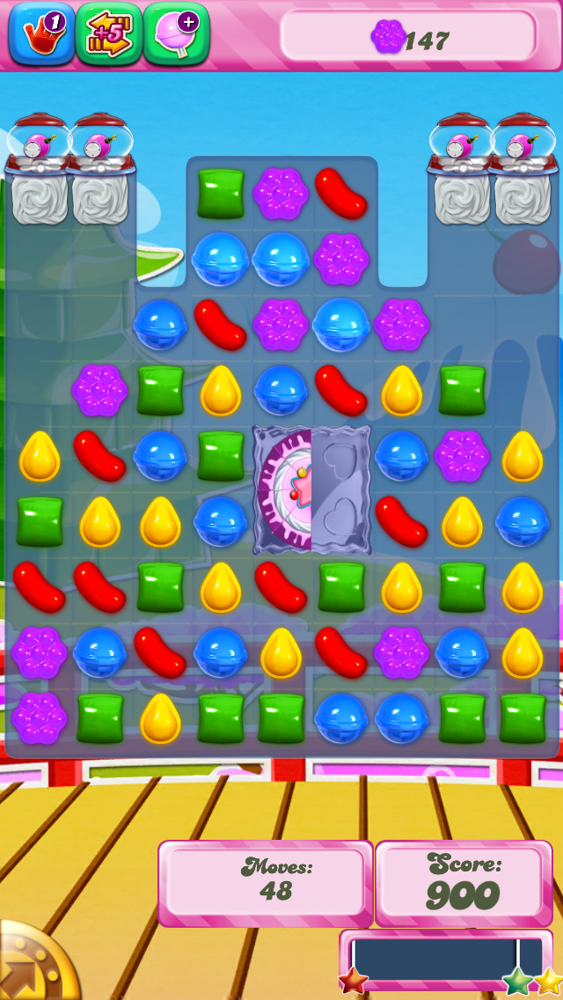
Sneaky Chance:
P-BOP Actions
Probability - Based On Player Actions
You can, under the hood, massage probability, but your players may notice and resent you.

Slide 27

Excel to get Number of Combinations
What the what?!?
Combination is the number of combinations for a given number of items.
Factorial : 4! = 4x3x2x1
Number of combinations of getting k tails in n coin tosses
Excel to the rescue: COMBIN(number,number_chosen)
Number is the number of items.
Number_chosen is the number of items in each combination.
Ex: 3 tails out of four tosses?
COMBIN(4,3) = 4
2^4 = 16
4/16 = ¼ = 25%

Slide 28
Monte Carlo Method
Simulate it with computer!
Or ask someone you know to simulate it : )
Python, php, c# are all good choices

Slide 29
Birthday Problem
Look it up : )
http://en.wikipedia.org/wiki/Birthday_problem

Slide 30
Thanks for listening!

