Slide 1
Programming for
Game Designers
Shawn Patton Guest Lecturer

Slide 2
From Zero to
Prototype
or Tips from Game Jams &
Project Prototyping

Slide 3



Who is this guy?
11 Years
Senior Game Designer
2 Years .25 Years

Slide 4






Projects

Slide 5

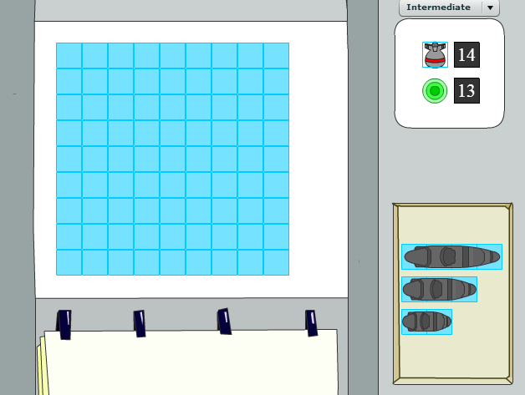
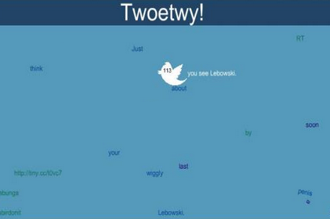
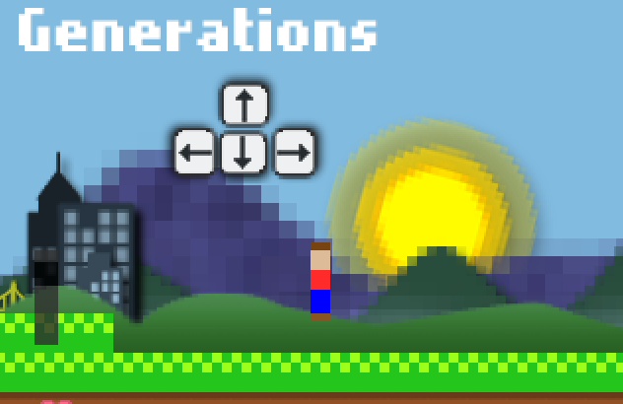
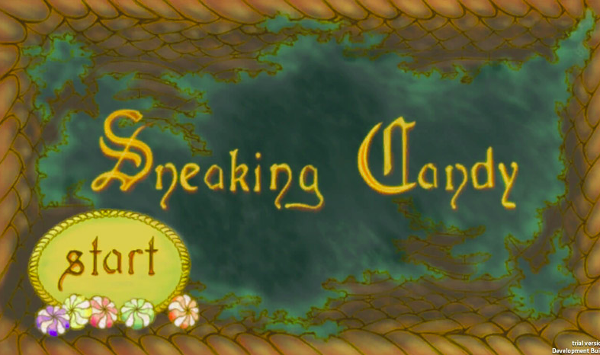
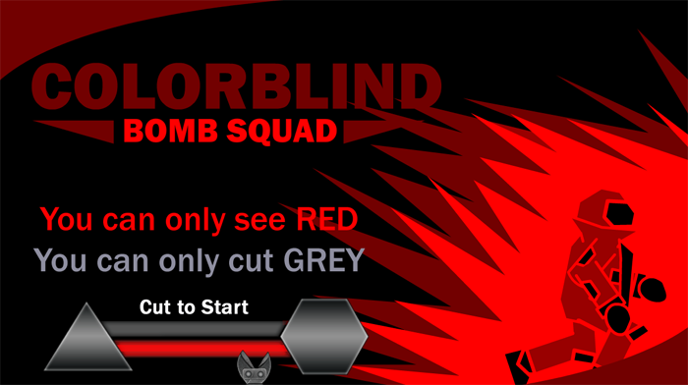
Global Game Jams
Ship
Sweepers
of
Spain
2009
2010
2011
2012
2013
2014

Slide 6
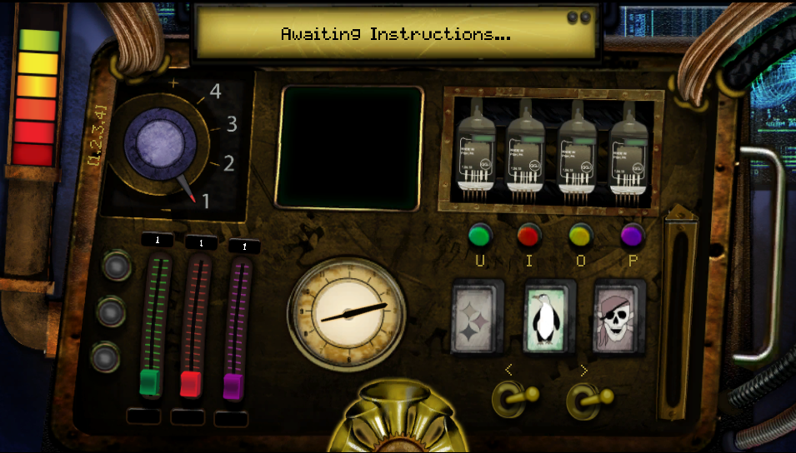
Global Game Jams
The
Machine
2015

Slide 7
Get to the Core
Try to identify the core of your game
What is fun or unique
How will I explain your game to others
Goal of prototype is to help you find that quickly

Slide 8
Methods
Paper prototypes
Parallel prototyping
One sheets
Constraints
Quick and dirty rule

Slide 9
Quick and Dirty Rule
Is it quick & dirty?
Yes
No
Is it core?
Do it
(maybe)
Yes
No
Cut It!

Slide 10
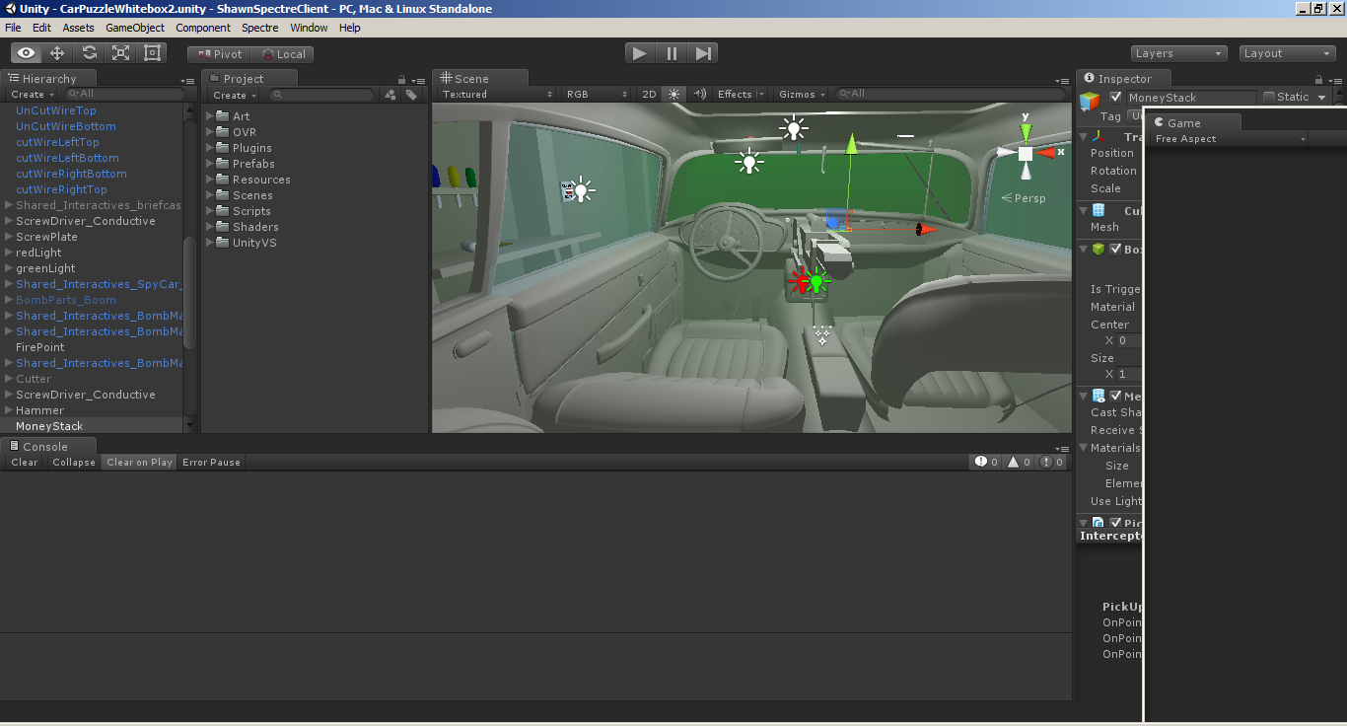
Prototypes on bigger projects

Slide 11
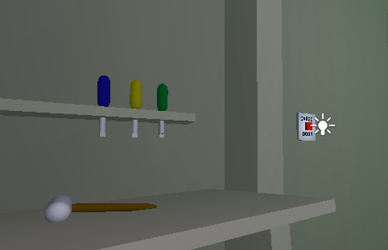
Careful of Corndogs

Slide 12
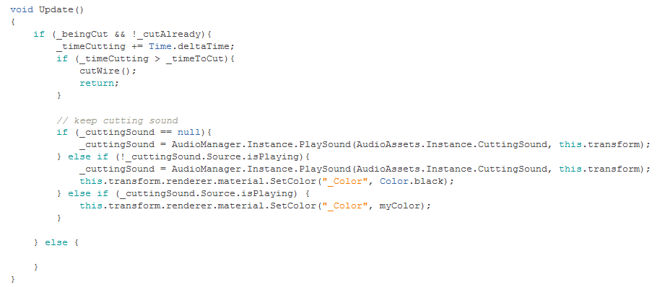
Careful of Code Slop

Slide 13
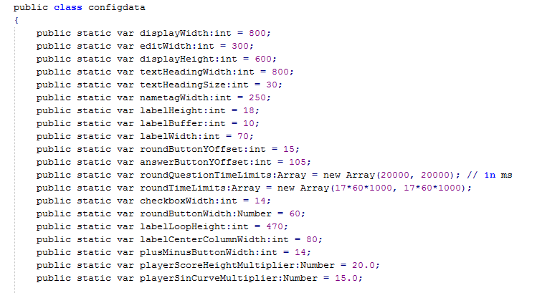
Configdata FTW

Slide 14
GGJ Tips & Tricks
Kyle Gabler’s 2009 Keynote:
https://www.youtube.com/watch?v=aW6vgW8wc6c&feature=youtu.be&t=1m37s
PIGDA’s GGJ Tips & Tricks
https://docs.google.com/presentation/d/1pQiEJjK56SQ9LGYU_X3VFjP3SRCV2DbGWJmChiK-7Us/edit#slide=id.g9f7d7dbe_0_757

Slide 15
Questions?
Thanks for listening!
Slides:
www.shawnpatton.com/prototyping

